Slide 1




PROTOTIPE SMART ELEVATOR PARKING SYSTEM BERBASIS INTERNET OF THINGS
PROGRAM STUDI DIPLOMA III TEKNIK ELEKTRONIKA
JURUSAN TEKNIK ELEKTRO – FAKULTAS TEKNIK
UNIVERSITAS NEGERI JAKARTA
2O20

Slide 2

IDENTITAS MAHASISWA
MAHASISWA 1
NAMA : MUHAMMAD IQBAL
NIM : 1507517018
PRODI : DIII TEKNIK
ELEKTRONIKA 2017
MAHASISWA 1
NAMA : IQBAL SYAHFII
NIM : 1507517059
PRODI : DIII TEKNIK
ELEKTRONIKA 2017
Notes:
Notes to presenter:
Description of what you learned in your own words on one side.
Include information about the topic
Details about the topic will also be helpful here.
Tell the story of your learning experience. Just like a story there should always be a beginning, middle and an end.
On the other side, you can add a graphic that provides evidence of what you learned.
Feel free to use more than one slide to reflect upon your process. It also helps to add some video of your process.

Slide 3

LATAR BELAKANG
PEMBOROSAN LAHAN DISEBABKAN PEMBANGUNAN LAHAN PARKIR.
KURANGNYA INFORMASI YANG DAPAT DIKETAHUI SEPUTAR FASILITAS PARKIR.
PERKEMBANGAN TEKNOLOGI INTERNET OF THINGS.
PENERAPAN INOVASI SISTEM PARKIR PINTAR
Notes:
Notes to presenter:
What is your purpose for sharing this reflection?
Is it at the end of a unit or project?
Are you sharing this reflection, at the attainment of a learning goal you set for yourself?
Is it at the end of a course?
State your purpose for the reflection or even the purpose of the learning experience or learning goal. Be clear and be specific in stating your purpose.

Slide 4
BATASAN MASALAH
Desain prototipe miniature parkir vertikal menggunakan elevator sebagai pemarkir otomatis
Menerapkan sistem counter untuk menghitung jumlah mobil yang terparkir.
Aplikasi yang menunjang kerja dari parkiran.
Notes:
Notes to presenter:
Description of what you learned in your own words on one side.
Include information about the topic
Details about the topic will also be helpful here.
Tell the story of your learning experience. Just like a story there should always be a beginning, middle and an end.
On the other side, you can add a graphic that provides evidence of what you learned.
Feel free to use more than one slide to reflect upon your process. It also helps to add some video of your process.

Slide 5

RUMUSAN MASALAH
Bagaimana cara kerja dari smart parking system ini ?
Seberapa baik sistem ini bila diterapkan?
Manfaat apa saja yang didapat bila menerapkan smart parking system ini ?
Notes:
Notes to presenter:
What steps will you be taking as a result of this learning experience?
Did you learn from any failed experiences? How will you do things differently?
What advice will you give to others so they can learn from your experiences?
How can you share what you learned with a real-world audience?
Some examples of next steps might be:
After delivering my first persuasive presentation, I am thinking about joining the debate team.
After making my first film, I’m considering entering it in our school film festival or local film festival.
After connecting with this career expert, I’d like to do some research on that career field because it sounds interesting to me.
This SmartArt allows you add images and text to help outline your process. If a picture is worth a thousand words, then pictures and words should help you communicate this reflection on learning perfectly! You can always click on Insert>SmartArt to change this graphic or select the graphic and click on the Design contextual menu to change the colors.
Feel free to use more than one slide to share your next steps. It also helps to add some video content to explain your message.

Slide 6
TUJUAN
Membuat sebuah inovasi yang menerapkan Internet of Things.
Dapat Berkontribusi dalam kemajuan teknologi Industri 4.0.
Membuat sebuah sistem yang dapat bermanfaat bagi masyarakat.
Sebagai syarat kelulusan.
Notes:
Notes to presenter:
What steps will you be taking as a result of this learning experience?
Did you learn from any failed experiences? How will you do things differently?
What advice will you give to others so they can learn from your experiences?
How can you share what you learned with a real-world audience?
Some examples of next steps might be:
After delivering my first persuasive presentation, I am thinking about joining the debate team.
After making my first film, I’m considering entering it in our school film festival or local film festival.
After connecting with this career expert, I’d like to do some research on that career field because it sounds interesting to me.
This SmartArt allows you add images and text to help outline your process. If a picture is worth a thousand words, then pictures and words should help you communicate this reflection on learning perfectly! You can always click on Insert>SmartArt to change this graphic or select the graphic and click on the Design contextual menu to change the colors.
Feel free to use more than one slide to share your next steps. It also helps to add some video content to explain your message.

Slide 7
DESAIN ALAT

Slide 8

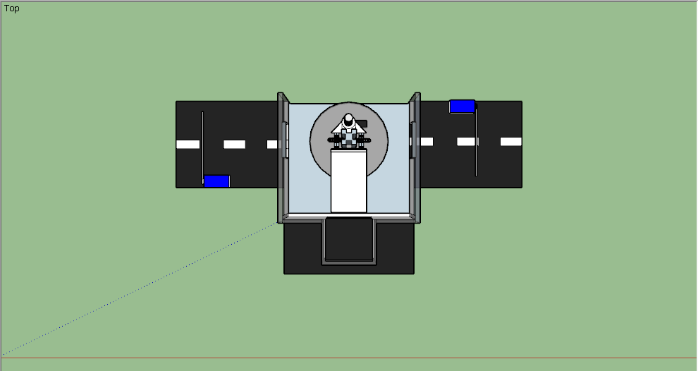
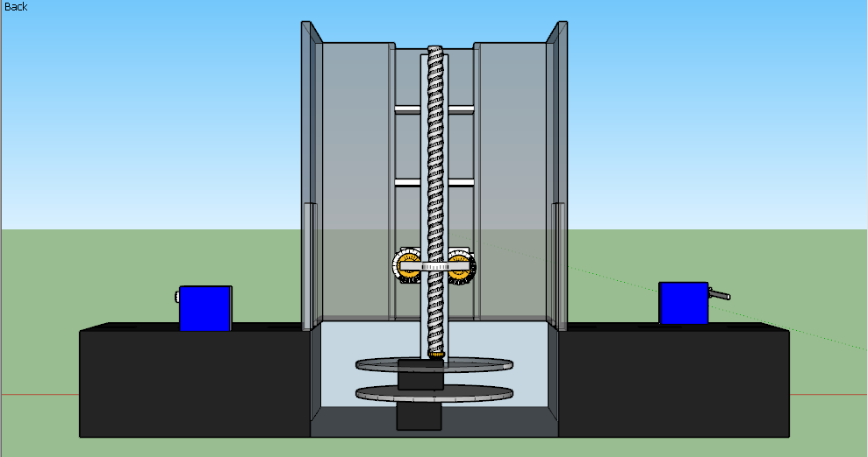
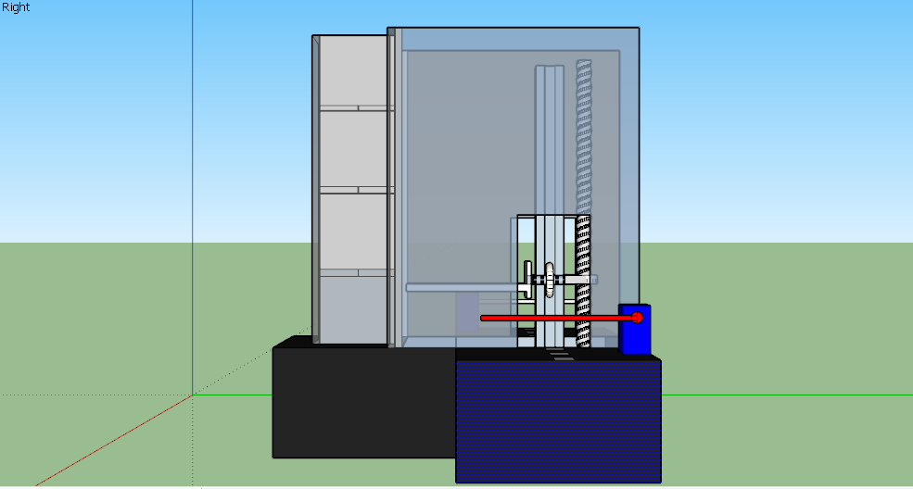
TAMPAK ATAS
TAMPAK DEPAN
TAMPAK SAMPING
Notes:
Notes to presenter:
What was important about this learning experience?
How is it relevant to your course, yourself, or your society or community?
Why is this significant?
This SmartArt allows you add images and text to help outline your process. If a picture is worth a thousand words, then pictures and words should help you communicate this reflection on learning perfectly! You can always click on Insert>SmartArt to change this graphic or select the graphic and click on the Design contextual menu to change the colors.

Slide 9
BLOK DIAGRAM

Slide 10
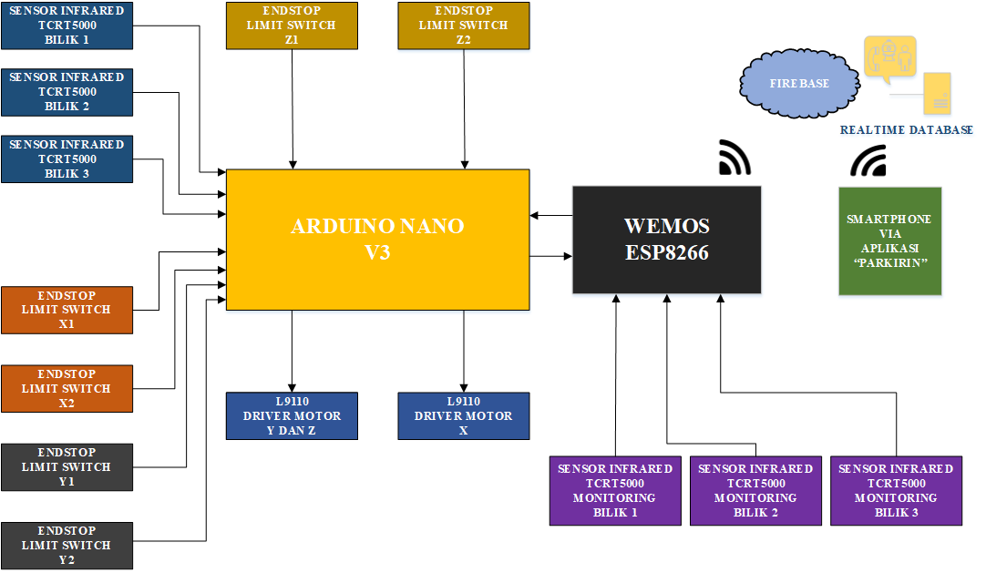

BLOK DIAGRAM CONTROLLER - 1
Notes:
Notes to presenter:
What did you think at first?
What obstacles did you encounter along the way?
How did you overcome those obstacles?
What images can you add to support your process?
This SmartArt allows you add images and text to help outline your process. If a picture is worth a thousand words, then pictures and words should help you communicate this reflection on learning perfectly! You can always click on Insert>SmartArt to change this graphic or select the graphic and click on the Design contextual menu to change the colors.
Feel free to use more than one slide to reflect upon your process. It also helps to add some video of your process.

Slide 11
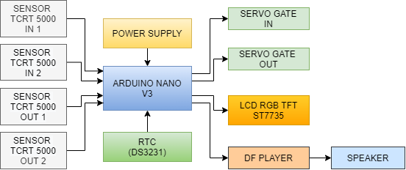
BLOK DIAGRAM CONTROLLER - 2
Notes:
Notes to presenter:
What did you think at first?
What obstacles did you encounter along the way?
How did you overcome those obstacles?
What images can you add to support your process?
This SmartArt allows you add images and text to help outline your process. If a picture is worth a thousand words, then pictures and words should help you communicate this reflection on learning perfectly! You can always click on Insert>SmartArt to change this graphic or select the graphic and click on the Design contextual menu to change the colors.
Feel free to use more than one slide to reflect upon your process. It also helps to add some video of your process.

Slide 12
FLOWCHART DIAGRAM

Slide 13

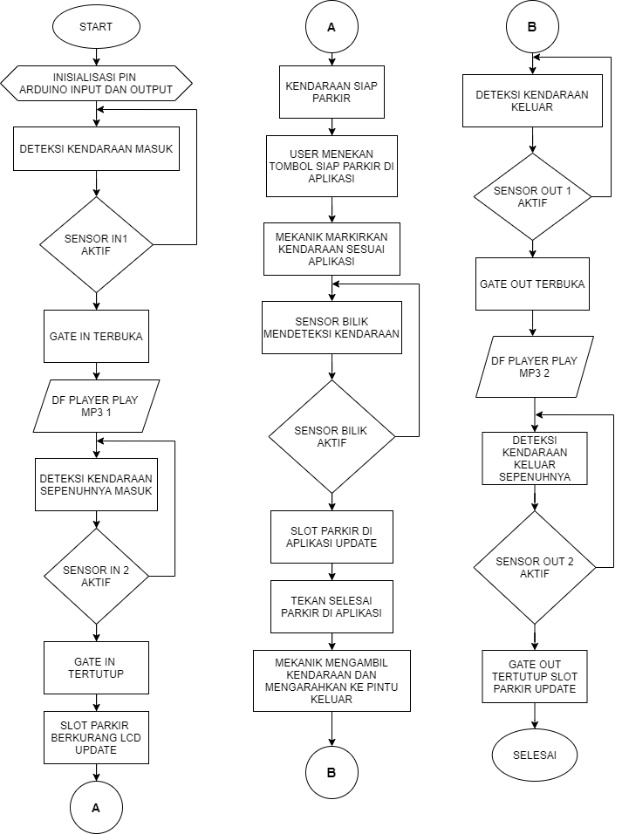
Content
Content
Content
Content
FLOWCHART DIAGRAM

Slide 14
PERANCANGAN HARDWARE (PERANGKAT KERAS)

Slide 15
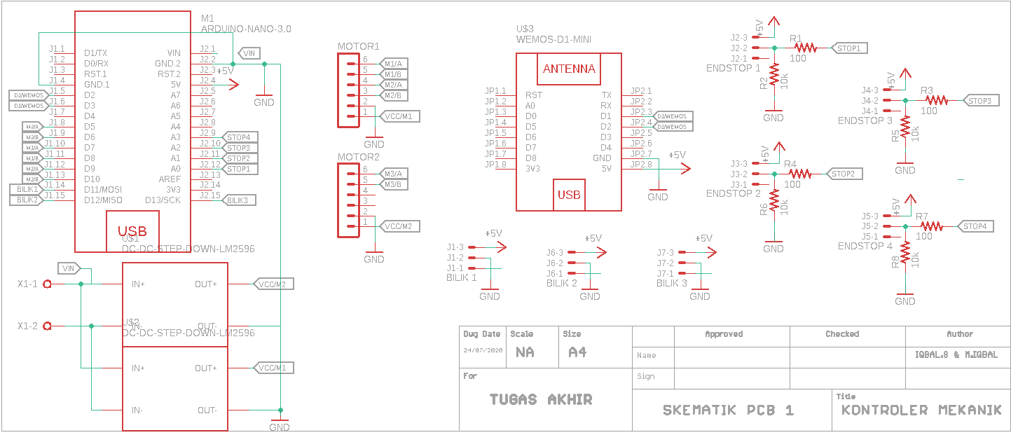
SKEMATIK CONTROLLER - 1
Notes:
Notes to presenter:
What did you think at first?
What obstacles did you encounter along the way?
How did you overcome those obstacles?
What images can you add to support your process?
This SmartArt allows you add images and text to help outline your process. If a picture is worth a thousand words, then pictures and words should help you communicate this reflection on learning perfectly! You can always click on Insert>SmartArt to change this graphic or select the graphic and click on the Design contextual menu to change the colors.
Feel free to use more than one slide to reflect upon your process. It also helps to add some video of your process.

Slide 16
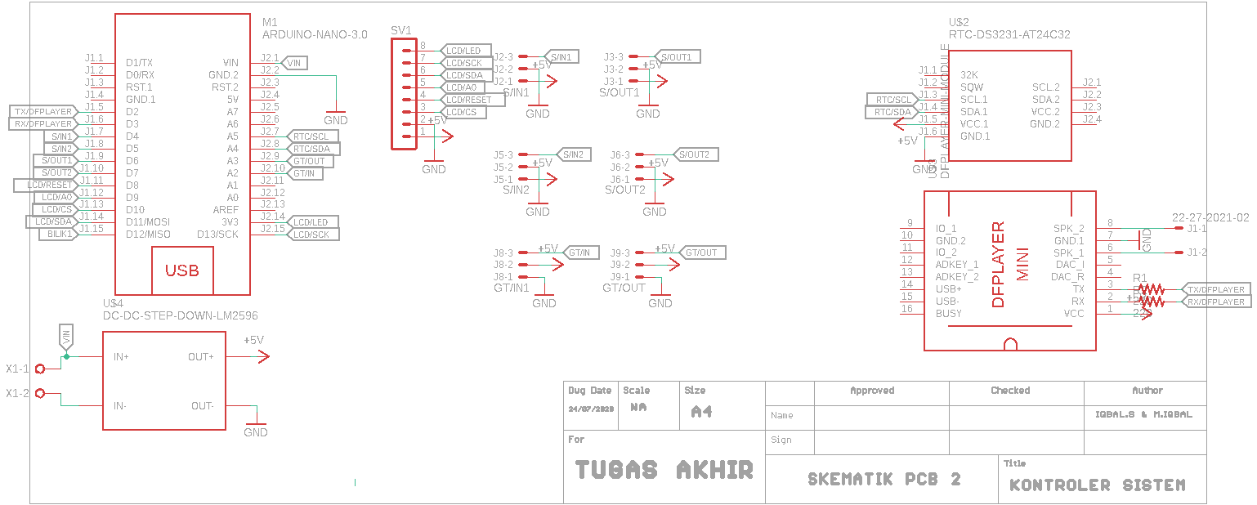
SKEMATIK CONTROLLER - 2
Notes:
Notes to presenter:
What did you think at first?
What obstacles did you encounter along the way?
How did you overcome those obstacles?
What images can you add to support your process?
This SmartArt allows you add images and text to help outline your process. If a picture is worth a thousand words, then pictures and words should help you communicate this reflection on learning perfectly! You can always click on Insert>SmartArt to change this graphic or select the graphic and click on the Design contextual menu to change the colors.
Feel free to use more than one slide to reflect upon your process. It also helps to add some video of your process.

Slide 17
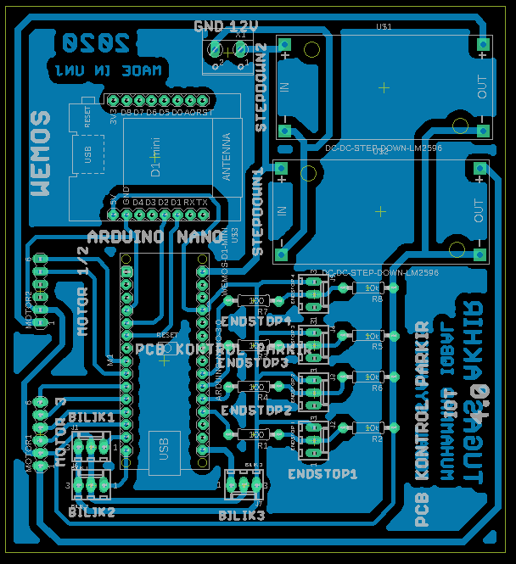
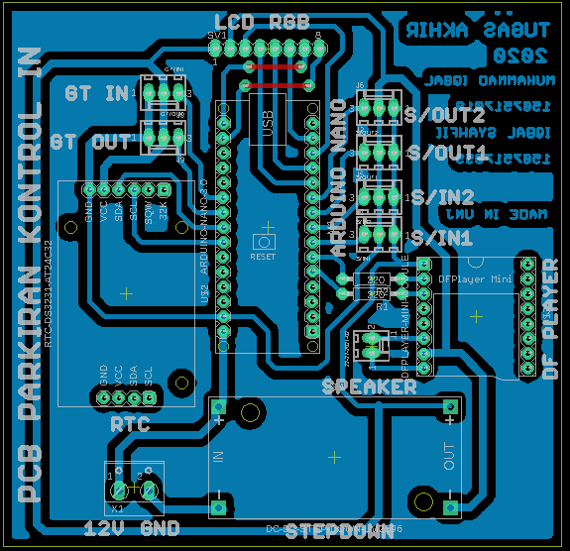
LAYOUT PCB CONTROLLER - 1
LAYOUT PCB
LAYOUT PCB CONTROLLER - 2
Notes:
Notes to presenter:
What steps will you be taking as a result of this learning experience?
Did you learn from any failed experiences? How will you do things differently?
What advice will you give to others so they can learn from your experiences?
How can you share what you learned with a real-world audience?
Some examples of next steps might be:
After delivering my first persuasive presentation, I am thinking about joining the debate team.
After making my first film, I’m considering entering it in our school film festival or local film festival.
After connecting with this career expert, I’d like to do some research on that career field because it sounds interesting to me.
This SmartArt allows you add images and text to help outline your process. If a picture is worth a thousand words, then pictures and words should help you communicate this reflection on learning perfectly! You can always click on Insert>SmartArt to change this graphic or select the graphic and click on the Design contextual menu to change the colors.
Feel free to use more than one slide to share your next steps. It also helps to add some video content to explain your message.

Slide 18
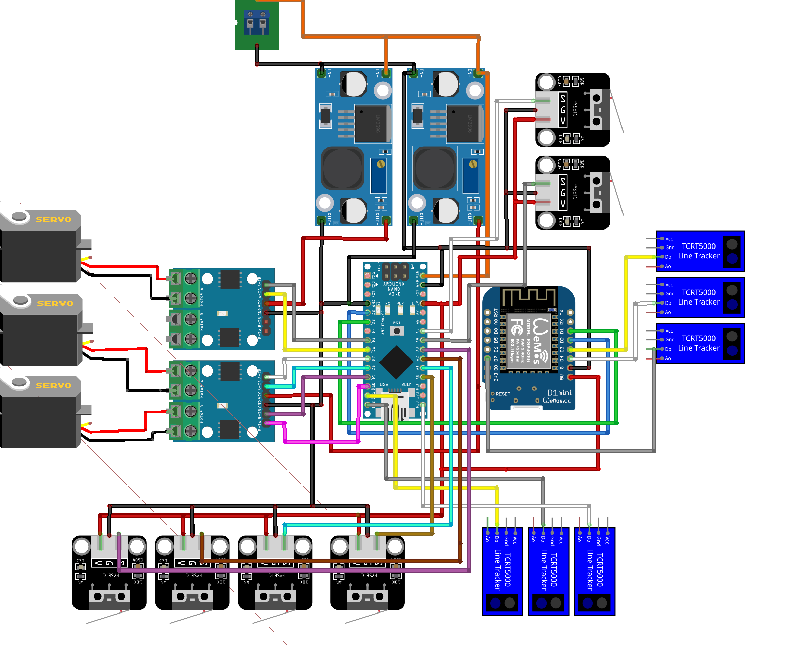
TABEL WIRING CONTROLLER 1
Notes:
Notes to presenter:
What steps will you be taking as a result of this learning experience?
Did you learn from any failed experiences? How will you do things differently?
What advice will you give to others so they can learn from your experiences?
How can you share what you learned with a real-world audience?
Some examples of next steps might be:
After delivering my first persuasive presentation, I am thinking about joining the debate team.
After making my first film, I’m considering entering it in our school film festival or local film festival.
After connecting with this career expert, I’d like to do some research on that career field because it sounds interesting to me.
This SmartArt allows you add images and text to help outline your process. If a picture is worth a thousand words, then pictures and words should help you communicate this reflection on learning perfectly! You can always click on Insert>SmartArt to change this graphic or select the graphic and click on the Design contextual menu to change the colors.
Feel free to use more than one slide to share your next steps. It also helps to add some video content to explain your message.

Slide 19
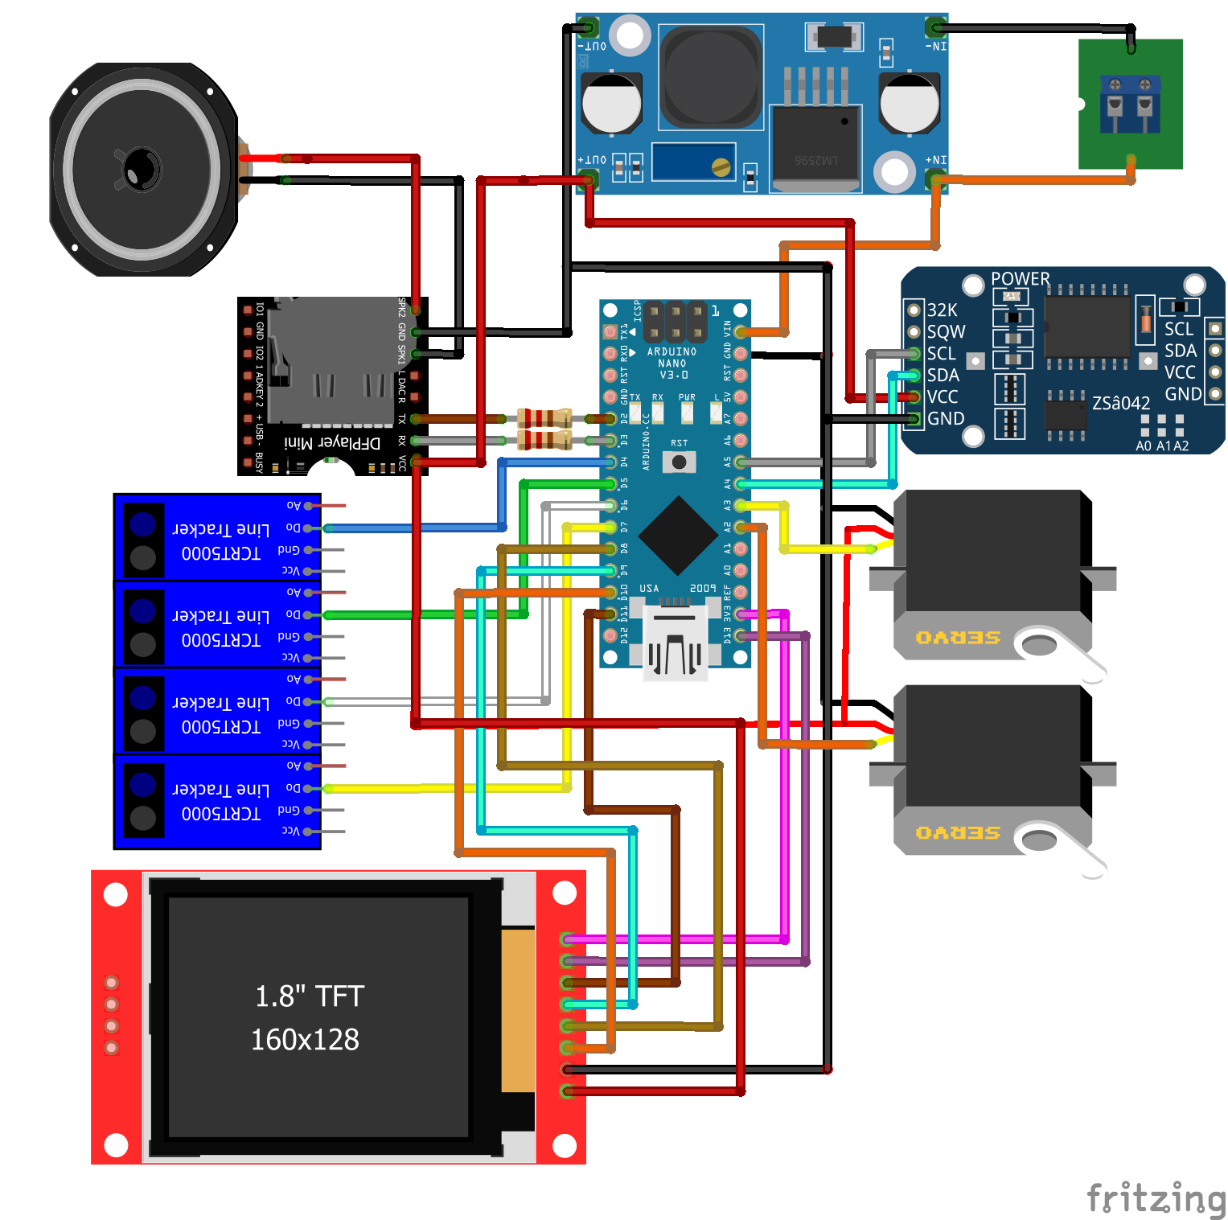
TABEL WIRING CONTROLLER 1
Notes:
Notes to presenter:
What steps will you be taking as a result of this learning experience?
Did you learn from any failed experiences? How will you do things differently?
What advice will you give to others so they can learn from your experiences?
How can you share what you learned with a real-world audience?
Some examples of next steps might be:
After delivering my first persuasive presentation, I am thinking about joining the debate team.
After making my first film, I’m considering entering it in our school film festival or local film festival.
After connecting with this career expert, I’d like to do some research on that career field because it sounds interesting to me.
This SmartArt allows you add images and text to help outline your process. If a picture is worth a thousand words, then pictures and words should help you communicate this reflection on learning perfectly! You can always click on Insert>SmartArt to change this graphic or select the graphic and click on the Design contextual menu to change the colors.
Feel free to use more than one slide to share your next steps. It also helps to add some video content to explain your message.

Slide 20
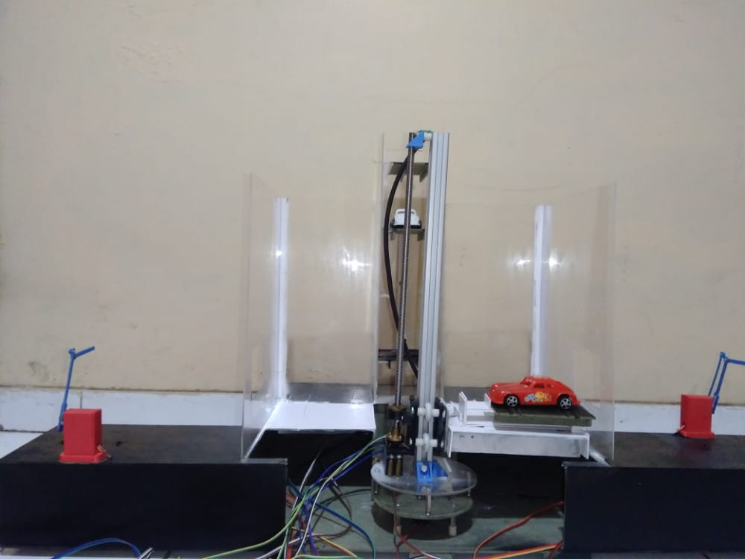
PEMBUATAN
MAKET

Slide 21

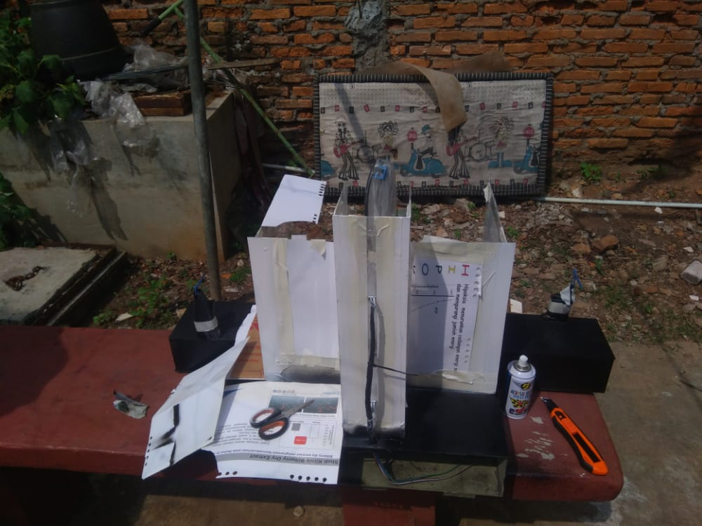
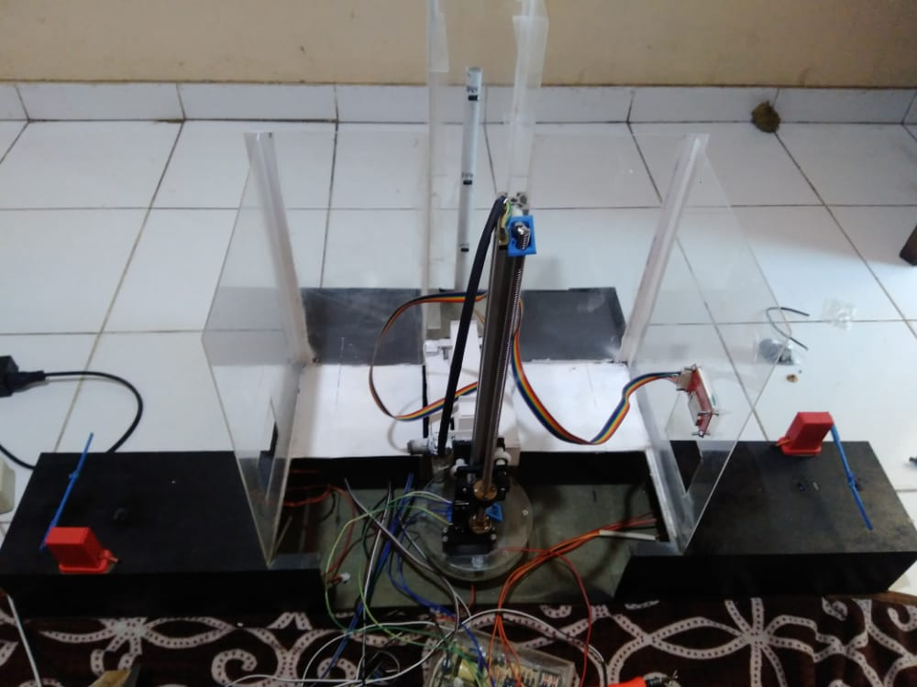
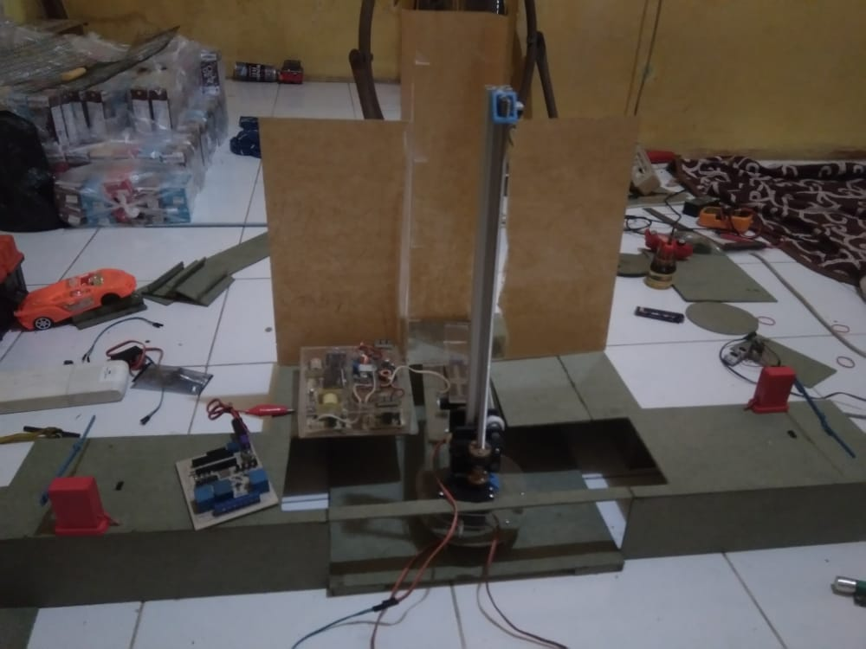
PAINTING
WIRING
ASSEMBLING
Notes:
Notes to presenter:
What was important about this learning experience?
How is it relevant to your course, yourself, or your society or community?
Why is this significant?
This SmartArt allows you add images and text to help outline your process. If a picture is worth a thousand words, then pictures and words should help you communicate this reflection on learning perfectly! You can always click on Insert>SmartArt to change this graphic or select the graphic and click on the Design contextual menu to change the colors.

Slide 22
PERANCANGAN SOFTWARE (PERANGKAT LUNAK)

Slide 23

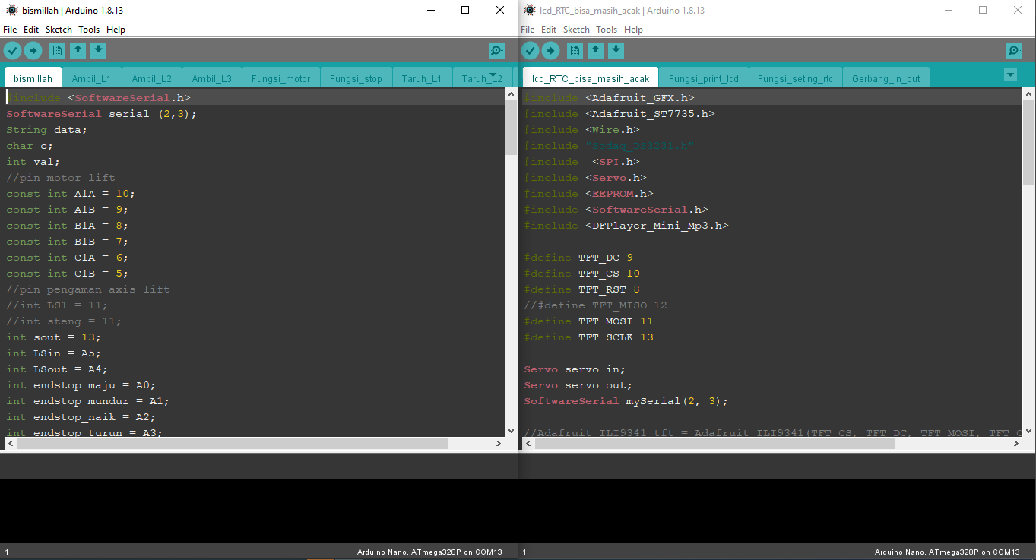
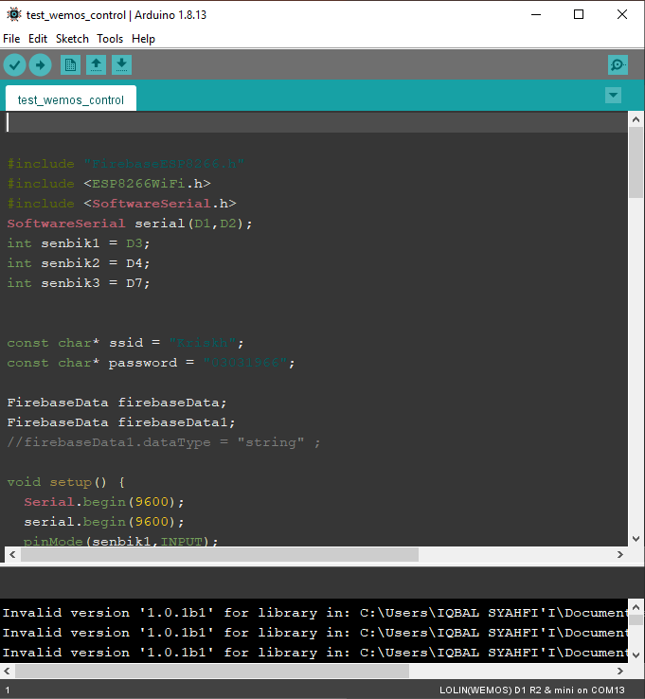
PROGRAM ARDUINO
Notes:
Notes to presenter:
What steps will you be taking as a result of this learning experience?
Did you learn from any failed experiences? How will you do things differently?
What advice will you give to others so they can learn from your experiences?
How can you share what you learned with a real-world audience?
Some examples of next steps might be:
After delivering my first persuasive presentation, I am thinking about joining the debate team.
After making my first film, I’m considering entering it in our school film festival or local film festival.
After connecting with this career expert, I’d like to do some research on that career field because it sounds interesting to me.
This SmartArt allows you add images and text to help outline your process. If a picture is worth a thousand words, then pictures and words should help you communicate this reflection on learning perfectly! You can always click on Insert>SmartArt to change this graphic or select the graphic and click on the Design contextual menu to change the colors.
Feel free to use more than one slide to share your next steps. It also helps to add some video content to explain your message.

Slide 24
KONFIGURASI FIREBASE
Notes:
Notes to presenter:
What steps will you be taking as a result of this learning experience?
Did you learn from any failed experiences? How will you do things differently?
What advice will you give to others so they can learn from your experiences?
How can you share what you learned with a real-world audience?
Some examples of next steps might be:
After delivering my first persuasive presentation, I am thinking about joining the debate team.
After making my first film, I’m considering entering it in our school film festival or local film festival.
After connecting with this career expert, I’d like to do some research on that career field because it sounds interesting to me.
This SmartArt allows you add images and text to help outline your process. If a picture is worth a thousand words, then pictures and words should help you communicate this reflection on learning perfectly! You can always click on Insert>SmartArt to change this graphic or select the graphic and click on the Design contextual menu to change the colors.
Feel free to use more than one slide to share your next steps. It also helps to add some video content to explain your message.

Slide 25
KONFIGURASI FIREBASE
1. BUKA FIREBASE
4
2. BUAT PROJECT
3
2
3. BUAT DATABASE
1
4. KONFIGURASI DATABASE
Notes:
Notes to presenter:
What steps will you be taking as a result of this learning experience?
Did you learn from any failed experiences? How will you do things differently?
What advice will you give to others so they can learn from your experiences?
How can you share what you learned with a real-world audience?
Some examples of next steps might be:
After delivering my first persuasive presentation, I am thinking about joining the debate team.
After making my first film, I’m considering entering it in our school film festival or local film festival.
After connecting with this career expert, I’d like to do some research on that career field because it sounds interesting to me.
This SmartArt allows you add images and text to help outline your process. If a picture is worth a thousand words, then pictures and words should help you communicate this reflection on learning perfectly! You can always click on Insert>SmartArt to change this graphic or select the graphic and click on the Design contextual menu to change the colors.
Feel free to use more than one slide to share your next steps. It also helps to add some video content to explain your message.

Slide 26
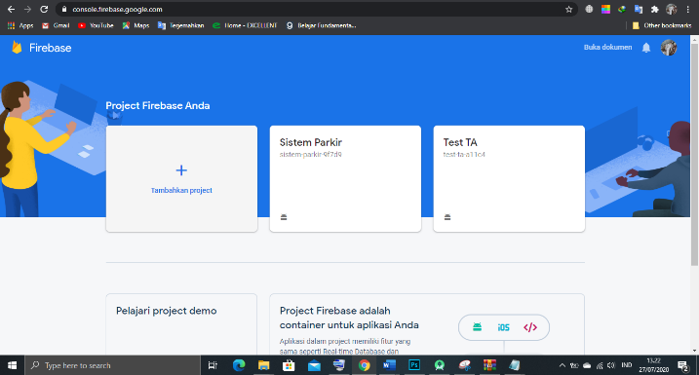
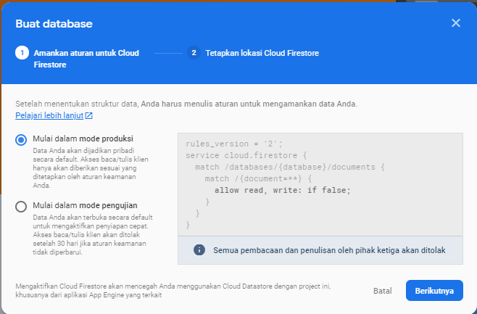
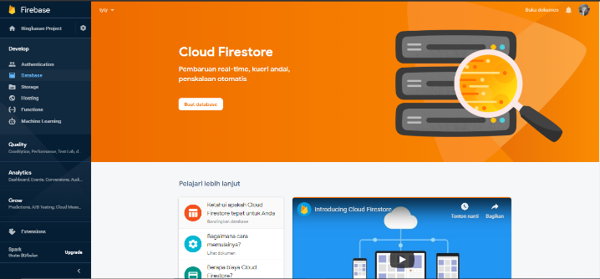
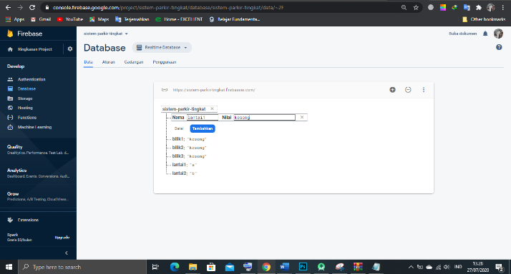
KONFIGURASI FIREBASE
Notes:
Notes to presenter:
What steps will you be taking as a result of this learning experience?
Did you learn from any failed experiences? How will you do things differently?
What advice will you give to others so they can learn from your experiences?
How can you share what you learned with a real-world audience?
Some examples of next steps might be:
After delivering my first persuasive presentation, I am thinking about joining the debate team.
After making my first film, I’m considering entering it in our school film festival or local film festival.
After connecting with this career expert, I’d like to do some research on that career field because it sounds interesting to me.
This SmartArt allows you add images and text to help outline your process. If a picture is worth a thousand words, then pictures and words should help you communicate this reflection on learning perfectly! You can always click on Insert>SmartArt to change this graphic or select the graphic and click on the Design contextual menu to change the colors.
Feel free to use more than one slide to share your next steps. It also helps to add some video content to explain your message.

Slide 27
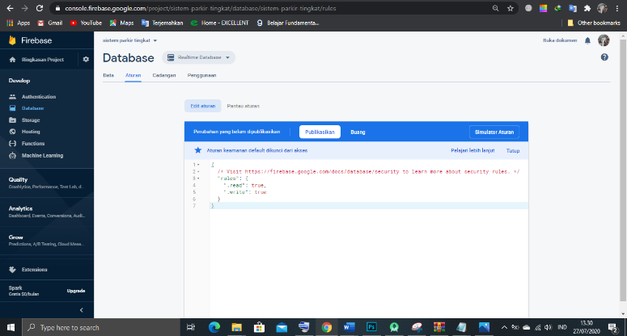
KONFIGURASI FIREBASE
Notes:
Notes to presenter:
What steps will you be taking as a result of this learning experience?
Did you learn from any failed experiences? How will you do things differently?
What advice will you give to others so they can learn from your experiences?
How can you share what you learned with a real-world audience?
Some examples of next steps might be:
After delivering my first persuasive presentation, I am thinking about joining the debate team.
After making my first film, I’m considering entering it in our school film festival or local film festival.
After connecting with this career expert, I’d like to do some research on that career field because it sounds interesting to me.
This SmartArt allows you add images and text to help outline your process. If a picture is worth a thousand words, then pictures and words should help you communicate this reflection on learning perfectly! You can always click on Insert>SmartArt to change this graphic or select the graphic and click on the Design contextual menu to change the colors.
Feel free to use more than one slide to share your next steps. It also helps to add some video content to explain your message.

Slide 28
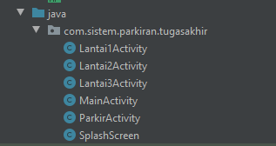
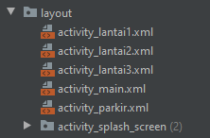
PEMBUATAN APLIKASI
Activity yang dibuat
Layout yang digunakan
Notes:
Notes to presenter:
What steps will you be taking as a result of this learning experience?
Did you learn from any failed experiences? How will you do things differently?
What advice will you give to others so they can learn from your experiences?
How can you share what you learned with a real-world audience?
Some examples of next steps might be:
After delivering my first persuasive presentation, I am thinking about joining the debate team.
After making my first film, I’m considering entering it in our school film festival or local film festival.
After connecting with this career expert, I’d like to do some research on that career field because it sounds interesting to me.
This SmartArt allows you add images and text to help outline your process. If a picture is worth a thousand words, then pictures and words should help you communicate this reflection on learning perfectly! You can always click on Insert>SmartArt to change this graphic or select the graphic and click on the Design contextual menu to change the colors.
Feel free to use more than one slide to share your next steps. It also helps to add some video content to explain your message.

Slide 29
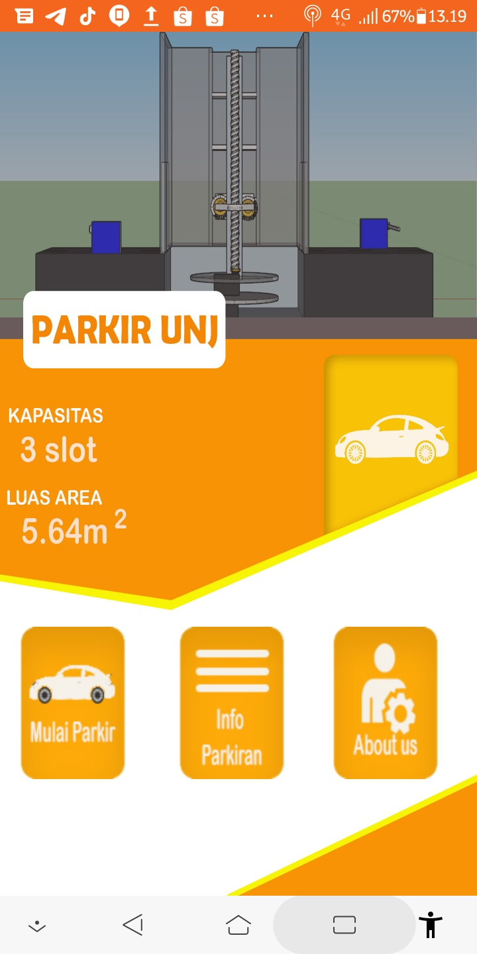
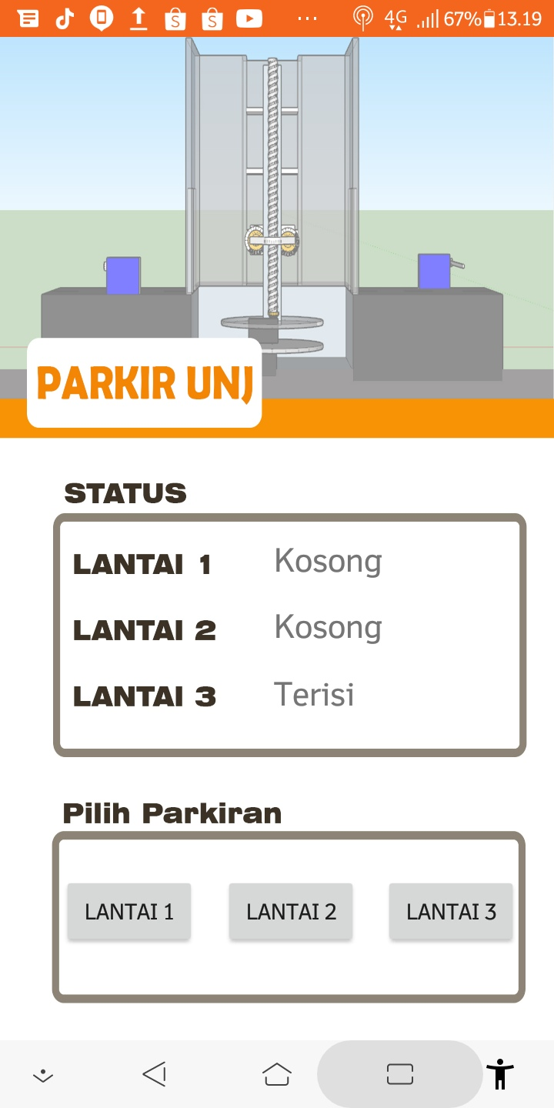
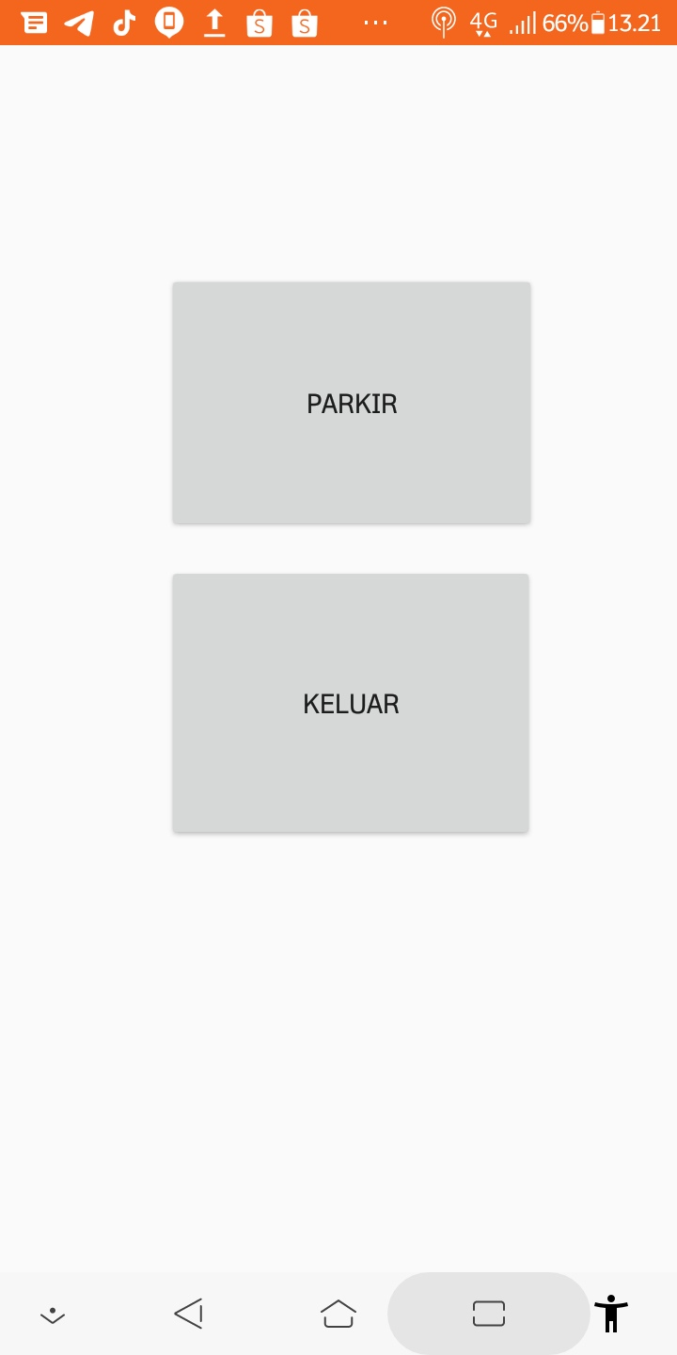
HASIL PEMBUATAN APLIKASI
Notes:
Notes to presenter:
What steps will you be taking as a result of this learning experience?
Did you learn from any failed experiences? How will you do things differently?
What advice will you give to others so they can learn from your experiences?
How can you share what you learned with a real-world audience?
Some examples of next steps might be:
After delivering my first persuasive presentation, I am thinking about joining the debate team.
After making my first film, I’m considering entering it in our school film festival or local film festival.
After connecting with this career expert, I’d like to do some research on that career field because it sounds interesting to me.
This SmartArt allows you add images and text to help outline your process. If a picture is worth a thousand words, then pictures and words should help you communicate this reflection on learning perfectly! You can always click on Insert>SmartArt to change this graphic or select the graphic and click on the Design contextual menu to change the colors.
Feel free to use more than one slide to share your next steps. It also helps to add some video content to explain your message.

Slide 30
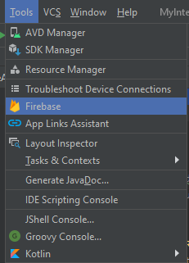
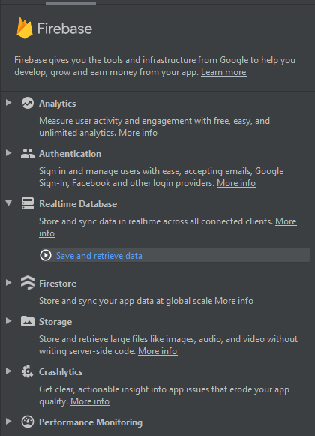
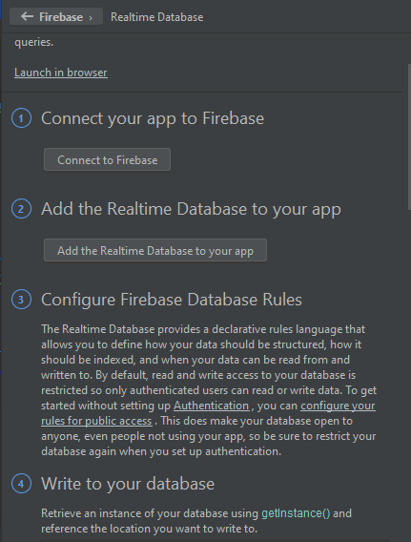
KONEKSI ANDROID KE FIREBASE
Notes:
Notes to presenter:
What steps will you be taking as a result of this learning experience?
Did you learn from any failed experiences? How will you do things differently?
What advice will you give to others so they can learn from your experiences?
How can you share what you learned with a real-world audience?
Some examples of next steps might be:
After delivering my first persuasive presentation, I am thinking about joining the debate team.
After making my first film, I’m considering entering it in our school film festival or local film festival.
After connecting with this career expert, I’d like to do some research on that career field because it sounds interesting to me.
This SmartArt allows you add images and text to help outline your process. If a picture is worth a thousand words, then pictures and words should help you communicate this reflection on learning perfectly! You can always click on Insert>SmartArt to change this graphic or select the graphic and click on the Design contextual menu to change the colors.
Feel free to use more than one slide to share your next steps. It also helps to add some video content to explain your message.

Slide 31
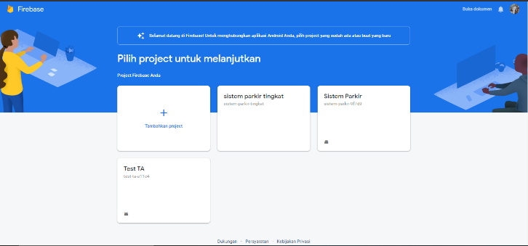
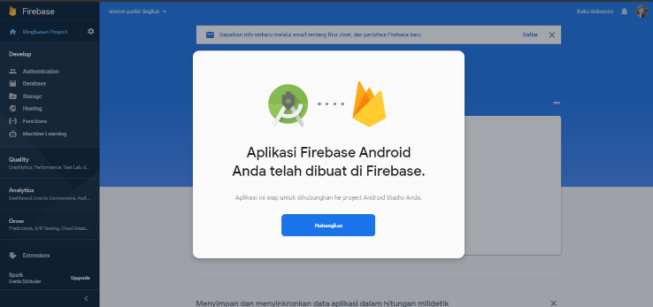
VERIFIKASI KONEKSI APLIKASI KE FIREBASE
Notes:
Notes to presenter:
What steps will you be taking as a result of this learning experience?
Did you learn from any failed experiences? How will you do things differently?
What advice will you give to others so they can learn from your experiences?
How can you share what you learned with a real-world audience?
Some examples of next steps might be:
After delivering my first persuasive presentation, I am thinking about joining the debate team.
After making my first film, I’m considering entering it in our school film festival or local film festival.
After connecting with this career expert, I’d like to do some research on that career field because it sounds interesting to me.
This SmartArt allows you add images and text to help outline your process. If a picture is worth a thousand words, then pictures and words should help you communicate this reflection on learning perfectly! You can always click on Insert>SmartArt to change this graphic or select the graphic and click on the Design contextual menu to change the colors.
Feel free to use more than one slide to share your next steps. It also helps to add some video content to explain your message.

Slide 32
PENGUJIAN ALAT

Slide 33
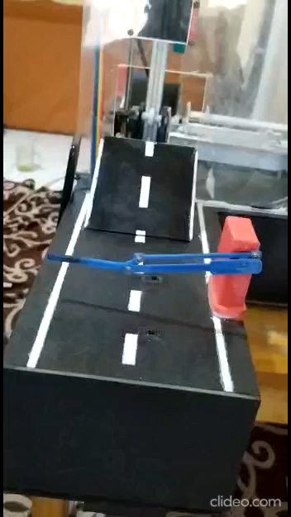
ALAT BEKERJA
Notes:
Notes to presenter:
What steps will you be taking as a result of this learning experience?
Did you learn from any failed experiences? How will you do things differently?
What advice will you give to others so they can learn from your experiences?
How can you share what you learned with a real-world audience?
Some examples of next steps might be:
After delivering my first persuasive presentation, I am thinking about joining the debate team.
After making my first film, I’m considering entering it in our school film festival or local film festival.
After connecting with this career expert, I’d like to do some research on that career field because it sounds interesting to me.
This SmartArt allows you add images and text to help outline your process. If a picture is worth a thousand words, then pictures and words should help you communicate this reflection on learning perfectly! You can always click on Insert>SmartArt to change this graphic or select the graphic and click on the Design contextual menu to change the colors.
Feel free to use more than one slide to share your next steps. It also helps to add some video content to explain your message.

Slide 34
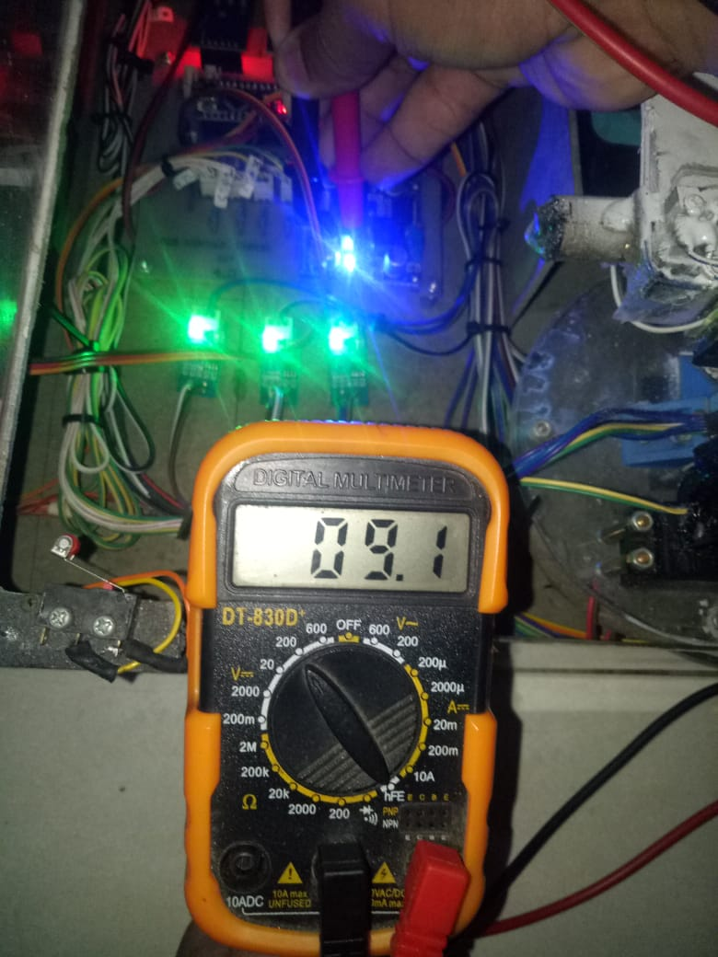
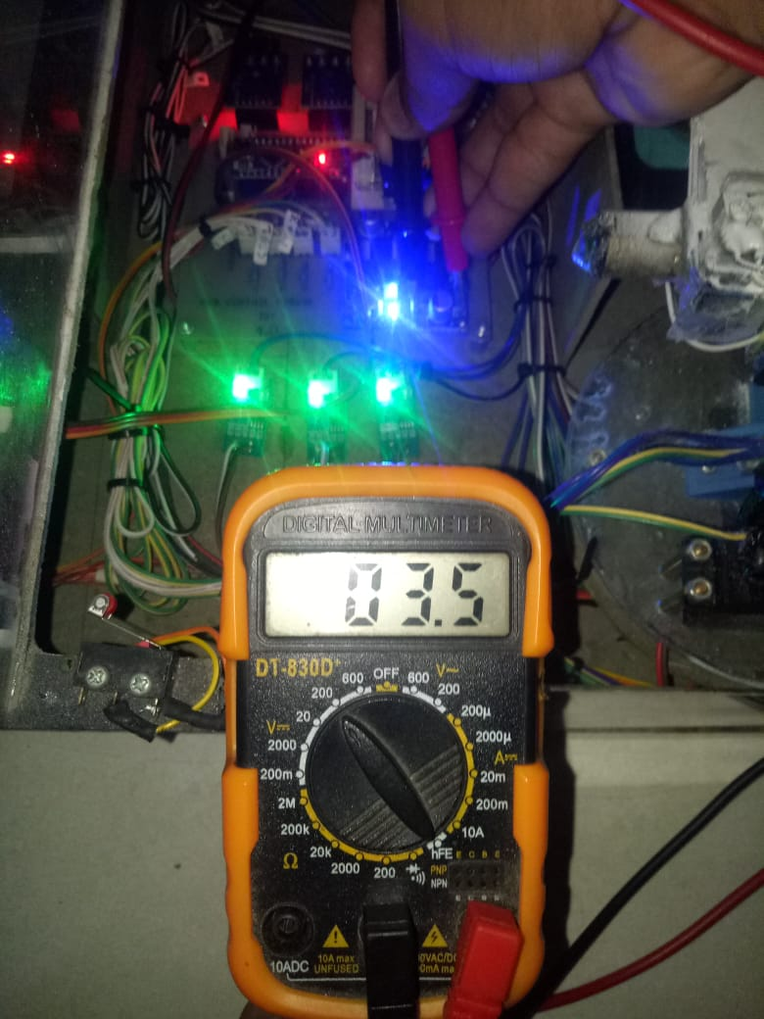
PENGUJIAN TEGANGAN MOTOR
MOTOR X DAN Y
MOTOR Z
Notes:
Notes to presenter:
What steps will you be taking as a result of this learning experience?
Did you learn from any failed experiences? How will you do things differently?
What advice will you give to others so they can learn from your experiences?
How can you share what you learned with a real-world audience?
Some examples of next steps might be:
After delivering my first persuasive presentation, I am thinking about joining the debate team.
After making my first film, I’m considering entering it in our school film festival or local film festival.
After connecting with this career expert, I’d like to do some research on that career field because it sounds interesting to me.
This SmartArt allows you add images and text to help outline your process. If a picture is worth a thousand words, then pictures and words should help you communicate this reflection on learning perfectly! You can always click on Insert>SmartArt to change this graphic or select the graphic and click on the Design contextual menu to change the colors.
Feel free to use more than one slide to share your next steps. It also helps to add some video content to explain your message.

Slide 35
PENGUJIAN TEGANGAN MOTOR
MOTOR X DAN Z
MOTOR Y
Notes:
Notes to presenter:
What steps will you be taking as a result of this learning experience?
Did you learn from any failed experiences? How will you do things differently?
What advice will you give to others so they can learn from your experiences?
How can you share what you learned with a real-world audience?
Some examples of next steps might be:
After delivering my first persuasive presentation, I am thinking about joining the debate team.
After making my first film, I’m considering entering it in our school film festival or local film festival.
After connecting with this career expert, I’d like to do some research on that career field because it sounds interesting to me.
This SmartArt allows you add images and text to help outline your process. If a picture is worth a thousand words, then pictures and words should help you communicate this reflection on learning perfectly! You can always click on Insert>SmartArt to change this graphic or select the graphic and click on the Design contextual menu to change the colors.
Feel free to use more than one slide to share your next steps. It also helps to add some video content to explain your message.

Slide 36
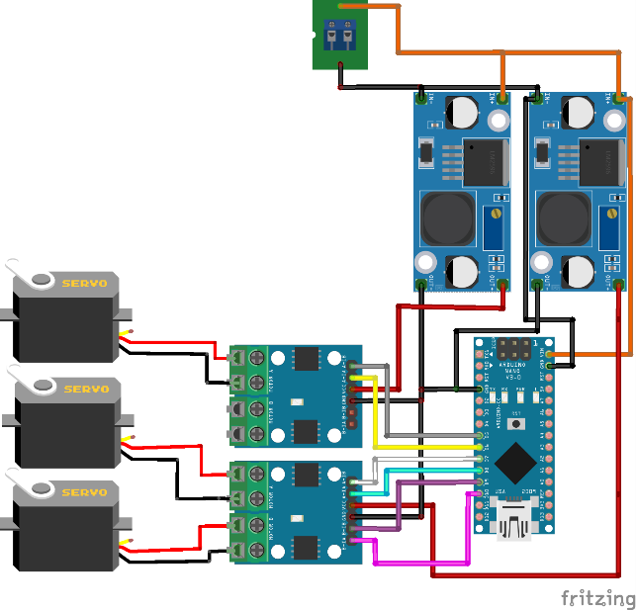
PENGUJIAN MOTOR
void naik(){
digitalWrite(A1A,LOW);
digitalWrite(A1B,HIGH);
}
void turun(){
digitalWrite(A1A,HIGH);
digitalWrite(A1B,LOW);
}
Notes:
Notes to presenter:
What steps will you be taking as a result of this learning experience?
Did you learn from any failed experiences? How will you do things differently?
What advice will you give to others so they can learn from your experiences?
How can you share what you learned with a real-world audience?
Some examples of next steps might be:
After delivering my first persuasive presentation, I am thinking about joining the debate team.
After making my first film, I’m considering entering it in our school film festival or local film festival.
After connecting with this career expert, I’d like to do some research on that career field because it sounds interesting to me.
This SmartArt allows you add images and text to help outline your process. If a picture is worth a thousand words, then pictures and words should help you communicate this reflection on learning perfectly! You can always click on Insert>SmartArt to change this graphic or select the graphic and click on the Design contextual menu to change the colors.
Feel free to use more than one slide to share your next steps. It also helps to add some video content to explain your message.

Slide 37
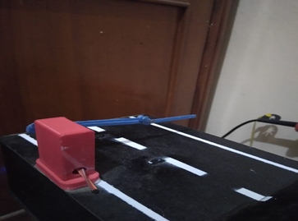
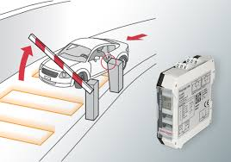
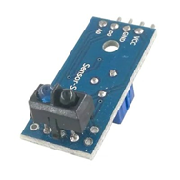

PENGUJIAN BARRIER GATE DAN SENSOR
SENSOR TCRT5000
INFRARED
SENSOR VLD
(VEHICLE LOOP DETECTOR)
Notes:
Notes to presenter:
What steps will you be taking as a result of this learning experience?
Did you learn from any failed experiences? How will you do things differently?
What advice will you give to others so they can learn from your experiences?
How can you share what you learned with a real-world audience?
Some examples of next steps might be:
After delivering my first persuasive presentation, I am thinking about joining the debate team.
After making my first film, I’m considering entering it in our school film festival or local film festival.
After connecting with this career expert, I’d like to do some research on that career field because it sounds interesting to me.
This SmartArt allows you add images and text to help outline your process. If a picture is worth a thousand words, then pictures and words should help you communicate this reflection on learning perfectly! You can always click on Insert>SmartArt to change this graphic or select the graphic and click on the Design contextual menu to change the colors.
Feel free to use more than one slide to share your next steps. It also helps to add some video content to explain your message.

Slide 38
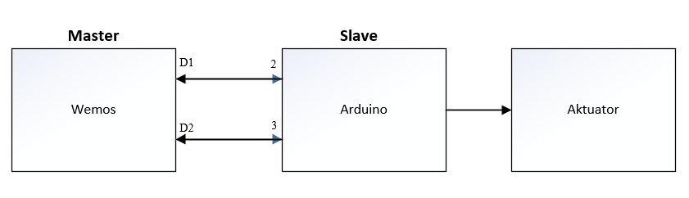
PENGUJIAN KOMUNIKASI SERIAL
BLOK DIAGRAM KOMUNIKASI SERIAL
Notes:
Notes to presenter:
What steps will you be taking as a result of this learning experience?
Did you learn from any failed experiences? How will you do things differently?
What advice will you give to others so they can learn from your experiences?
How can you share what you learned with a real-world audience?
Some examples of next steps might be:
After delivering my first persuasive presentation, I am thinking about joining the debate team.
After making my first film, I’m considering entering it in our school film festival or local film festival.
After connecting with this career expert, I’d like to do some research on that career field because it sounds interesting to me.
This SmartArt allows you add images and text to help outline your process. If a picture is worth a thousand words, then pictures and words should help you communicate this reflection on learning perfectly! You can always click on Insert>SmartArt to change this graphic or select the graphic and click on the Design contextual menu to change the colors.
Feel free to use more than one slide to share your next steps. It also helps to add some video content to explain your message.

Slide 39
PENGUJIAN KOMUNIKASI SERIAL
Program komunikasi serial pada Wemos:
#include <SoftwareSerial.h>
SoftwareSerial serial(D1,D2)
Program komunikasi serial pada Arduino:
#include <SoftwareSerial.h>
SoftwareSerial serial (2,3);
Notes:
Notes to presenter:
What steps will you be taking as a result of this learning experience?
Did you learn from any failed experiences? How will you do things differently?
What advice will you give to others so they can learn from your experiences?
How can you share what you learned with a real-world audience?
Some examples of next steps might be:
After delivering my first persuasive presentation, I am thinking about joining the debate team.
After making my first film, I’m considering entering it in our school film festival or local film festival.
After connecting with this career expert, I’d like to do some research on that career field because it sounds interesting to me.
This SmartArt allows you add images and text to help outline your process. If a picture is worth a thousand words, then pictures and words should help you communicate this reflection on learning perfectly! You can always click on Insert>SmartArt to change this graphic or select the graphic and click on the Design contextual menu to change the colors.
Feel free to use more than one slide to share your next steps. It also helps to add some video content to explain your message.

Slide 40
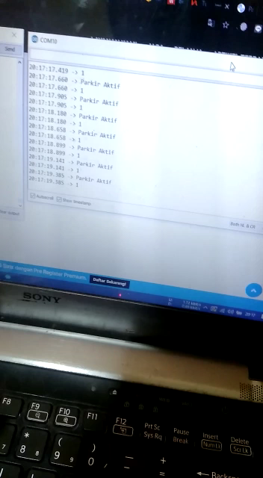
PENGUJIAN KOMUNIKASI SERIAL
Notes:
Notes to presenter:
What steps will you be taking as a result of this learning experience?
Did you learn from any failed experiences? How will you do things differently?
What advice will you give to others so they can learn from your experiences?
How can you share what you learned with a real-world audience?
Some examples of next steps might be:
After delivering my first persuasive presentation, I am thinking about joining the debate team.
After making my first film, I’m considering entering it in our school film festival or local film festival.
After connecting with this career expert, I’d like to do some research on that career field because it sounds interesting to me.
This SmartArt allows you add images and text to help outline your process. If a picture is worth a thousand words, then pictures and words should help you communicate this reflection on learning perfectly! You can always click on Insert>SmartArt to change this graphic or select the graphic and click on the Design contextual menu to change the colors.
Feel free to use more than one slide to share your next steps. It also helps to add some video content to explain your message.

Slide 41
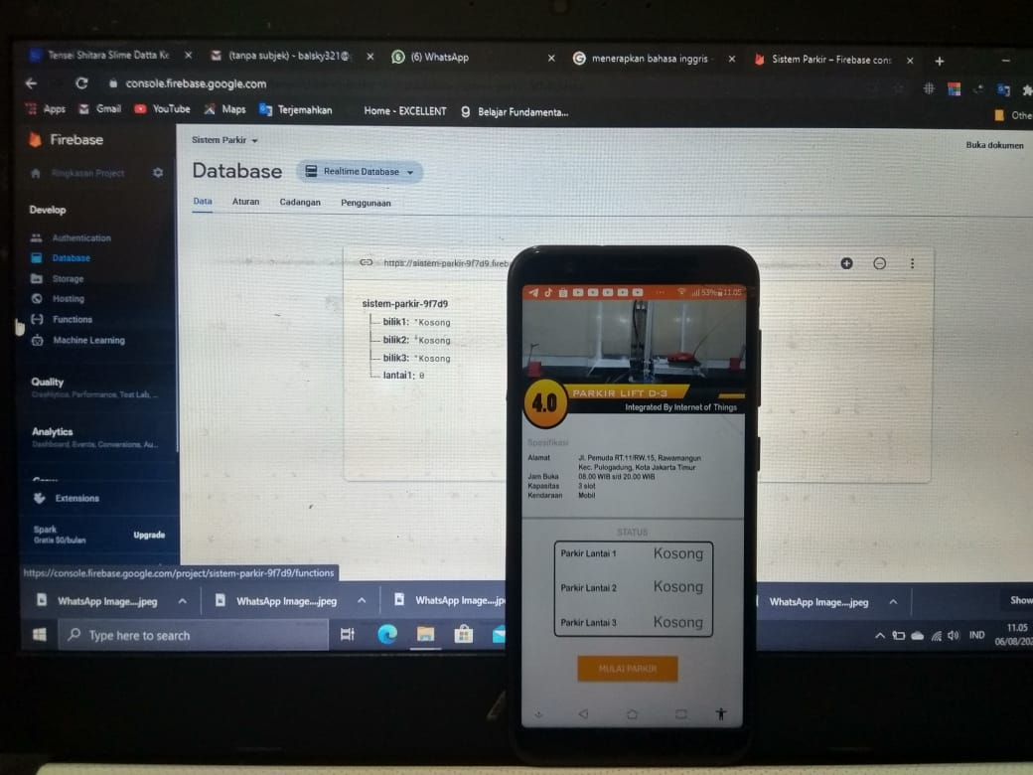
PENGUJIAN KONEKTIFITAS ANDROID KE FIREBASE
PENGUJIAN MONITORING MELALUI APLIKASI
Program Wemos writebase data ke Firebase
if (digitalRead(sensor) == 1) {
if (firebaseData1.dataType() == "string") {
Firebase.setString(firebaseData1,"bilik1", kosong); }}
Program Aplikasi read database ke Firebase
@Override
public void onDataChange(DataSnapshot dataSnapshot) {
stat1 dataSnapshot.child("bilik1").getValue().toString();
l1.setText(stat1);}
Notes:
Notes to presenter:
What steps will you be taking as a result of this learning experience?
Did you learn from any failed experiences? How will you do things differently?
What advice will you give to others so they can learn from your experiences?
How can you share what you learned with a real-world audience?
Some examples of next steps might be:
After delivering my first persuasive presentation, I am thinking about joining the debate team.
After making my first film, I’m considering entering it in our school film festival or local film festival.
After connecting with this career expert, I’d like to do some research on that career field because it sounds interesting to me.
This SmartArt allows you add images and text to help outline your process. If a picture is worth a thousand words, then pictures and words should help you communicate this reflection on learning perfectly! You can always click on Insert>SmartArt to change this graphic or select the graphic and click on the Design contextual menu to change the colors.
Feel free to use more than one slide to share your next steps. It also helps to add some video content to explain your message.

Slide 42
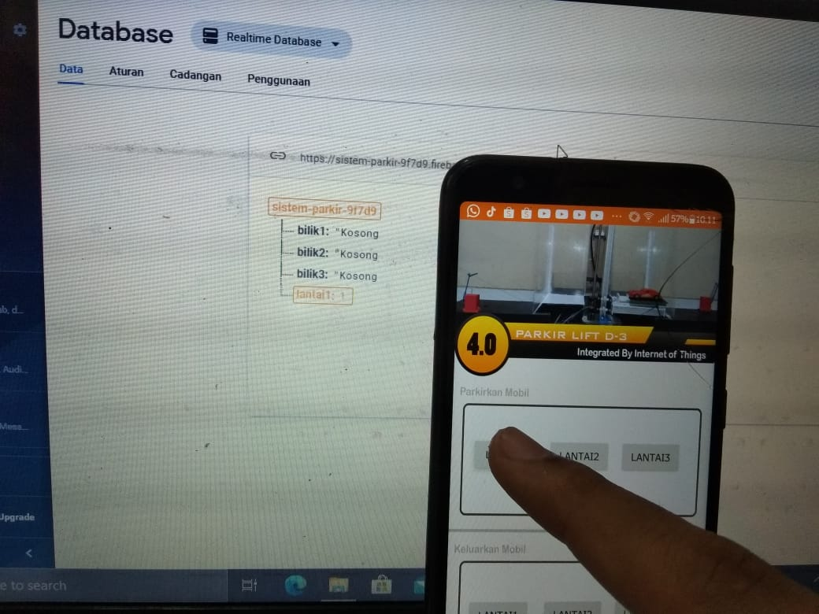
PENGUJIAN KONEKTIFITAS ANDROID KE FIREBASE
PENGUJIAN CONTROLLING MELALUI APLIKASI
Program Wemos, read database dari Firebase
if (Firebase.getInt(firebaseData, "lantai1")) {
if (firebaseData.dataType() == "int"){
int FBStatus1 = firebaseData.intData();
if (FBStatus1 == 1) {
serial.println(FBStatus1);}
Program Aplikasi, write database ke Firebase
@Override
public void onDataChange(DataSnapshot dataSnapshot) {
stat1 dataSnapshot.child("bilik1").getValue().toString();
l1.setText(stat1);}
Notes:
Notes to presenter:
What steps will you be taking as a result of this learning experience?
Did you learn from any failed experiences? How will you do things differently?
What advice will you give to others so they can learn from your experiences?
How can you share what you learned with a real-world audience?
Some examples of next steps might be:
After delivering my first persuasive presentation, I am thinking about joining the debate team.
After making my first film, I’m considering entering it in our school film festival or local film festival.
After connecting with this career expert, I’d like to do some research on that career field because it sounds interesting to me.
This SmartArt allows you add images and text to help outline your process. If a picture is worth a thousand words, then pictures and words should help you communicate this reflection on learning perfectly! You can always click on Insert>SmartArt to change this graphic or select the graphic and click on the Design contextual menu to change the colors.
Feel free to use more than one slide to share your next steps. It also helps to add some video content to explain your message.

Slide 43
KESIMPULAN
Ketika mobil peraga menyentuh sensor infrared di barrier gate-in, maka barrier gate-in akan terbuka diikuti dengan sound “selamat datang di parkiran tingkat pintar” dari DF Player yang outputnya melalui speaker, kemudian gate akan tertutup lagi bila mobil menyentuh sensor infrared yang dipasang setelah barrier gate-in dan akan terbaca apabila mobil telah selesai melewati sensor tersebut.
Tersedia parkiran yang disusun secara vertikal, yang mana menerapkan system parkir automatis menggunakan elevator system yang terintegrasi dengan sebuah aplikasi smartphone
Aplikasi “Parkirin”, yang dibuat sebagai platform untuk mengendalikan kerja dari parkiran, sehingga dapat menentukan posisi lantai parkir yang diinginkan, dan media penghubung antara parkir dan aplikasi adalah media internet.
Mobil yang telah terparkir, dapat dikeluarkan menggunakan aplikasi yang menyediakan tombol keluar. “.
Mobil yang telah terkonfirmasi ingin keluar, akan segera diangkut oleh elevator menuju gate-out, setelah mobil keluar dari elevator, elevator akan kembali ke posisi semula.
Mobil yang menyentuh sensor infrared yang ada pada barrier gate-out, maka gate akan terbuka dan diikut dengan sound “terima kasih telah parkir di parkiran tingkat pintar”, dan gate yang telah terbuka, akan tertutup lagi jika kendaraan telah selesai melewati sensor infrared yang tersedia .
Notes:
Notes to presenter:
What steps will you be taking as a result of this learning experience?
Did you learn from any failed experiences? How will you do things differently?
What advice will you give to others so they can learn from your experiences?
How can you share what you learned with a real-world audience?
Some examples of next steps might be:
After delivering my first persuasive presentation, I am thinking about joining the debate team.
After making my first film, I’m considering entering it in our school film festival or local film festival.
After connecting with this career expert, I’d like to do some research on that career field because it sounds interesting to me.
This SmartArt allows you add images and text to help outline your process. If a picture is worth a thousand words, then pictures and words should help you communicate this reflection on learning perfectly! You can always click on Insert>SmartArt to change this graphic or select the graphic and click on the Design contextual menu to change the colors.
Feel free to use more than one slide to share your next steps. It also helps to add some video content to explain your message.

Slide 44
SARAN
Pastikan sumber tegangan berfungsi dengan baik, dikarenakan bila terjadi kendala mati listrik, alat ini tidak dapat berfungsi dengan baik.
Membutuhkan koneksi internet yang stabil, karena bila user menggunakan koneksi yang tidak stabil, maka data yang diterima dari aplikasi menuju firebase akan terdelay dan menyebabkan data tertumpuk.
Bentuk maket yang masih kurang memadai menyebabkan terkadang terjadinya kesalahan teknis saat alat bekerja.
Notes:
Notes to presenter:
What steps will you be taking as a result of this learning experience?
Did you learn from any failed experiences? How will you do things differently?
What advice will you give to others so they can learn from your experiences?
How can you share what you learned with a real-world audience?
Some examples of next steps might be:
After delivering my first persuasive presentation, I am thinking about joining the debate team.
After making my first film, I’m considering entering it in our school film festival or local film festival.
After connecting with this career expert, I’d like to do some research on that career field because it sounds interesting to me.
This SmartArt allows you add images and text to help outline your process. If a picture is worth a thousand words, then pictures and words should help you communicate this reflection on learning perfectly! You can always click on Insert>SmartArt to change this graphic or select the graphic and click on the Design contextual menu to change the colors.
Feel free to use more than one slide to share your next steps. It also helps to add some video content to explain your message.

Slide 45
Importance
Relevance
Significance
Notes:
Notes to presenter:
What was important about this learning experience?
How is it relevant to your course, yourself, or your society or community?
Why is this significant?
This SmartArt allows you add images and text to help outline your process. If a picture is worth a thousand words, then pictures and words should help you communicate this reflection on learning perfectly! You can always click on Insert>SmartArt to change this graphic or select the graphic and click on the Design contextual menu to change the colors.

Slide 46
TERIMA KASIH
SEMOGA BERKAH

